Slide 1

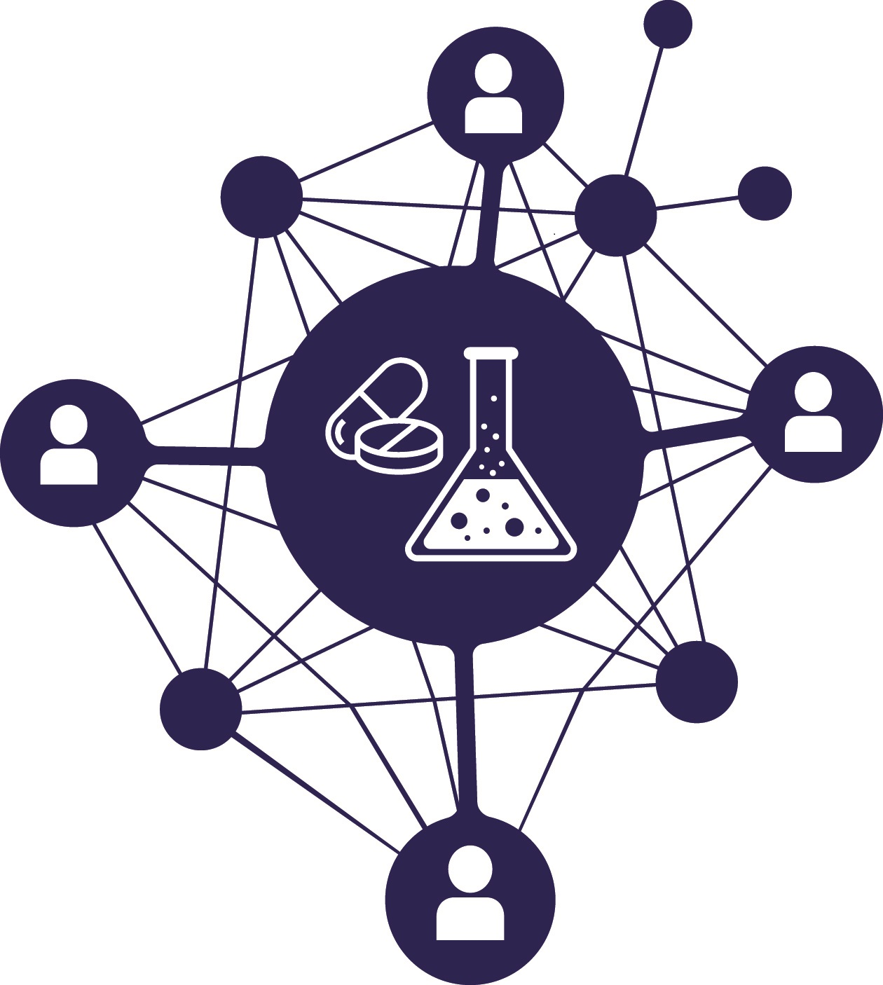
BIOMEDICAL NETWORK - Members meeting, Bikuben, HUH, Bergen, 22.09 2016, 15:00-18:30
https://bergento.no/event/biomedical-network-members-meeting
Computational medicine
( Beregningsorientert medisin )
17:35-17:50
Prof. Arvid Lundervold BSc, MD, PhD
Department of Biomedicine, University of Bergen &
Department of Radiology, Haukeland University Hospital, Bergen, Norway
https://github.com/arvidl/computational-medicine

Slide 2
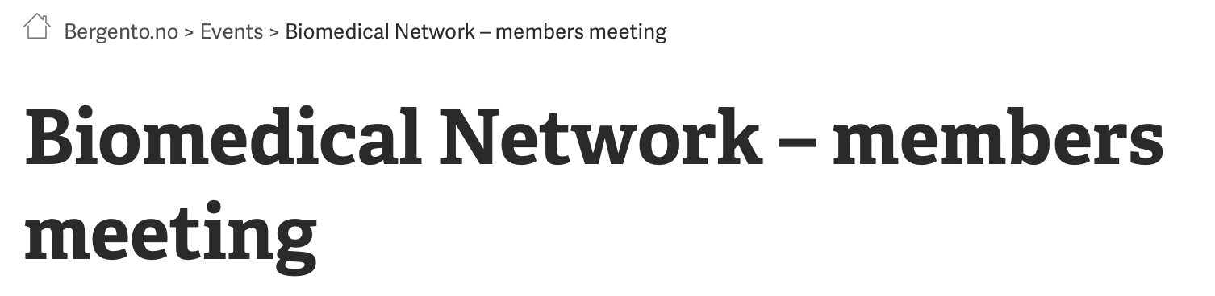


Biomedical Network is a network collaboration between Haukeland University Hospital, University of Bergen, Legemiddelindustrien and Bergen Teknologioverføring (BTO).
The aim is to establish a common platform for innovation and project development across academic and between public and private actors.
This meeting is the first in a series that will contribute to collaborative research between researchers, research institutions and companies.
How does “Computational medicine” fit in ?
TRENDS

Slide 3
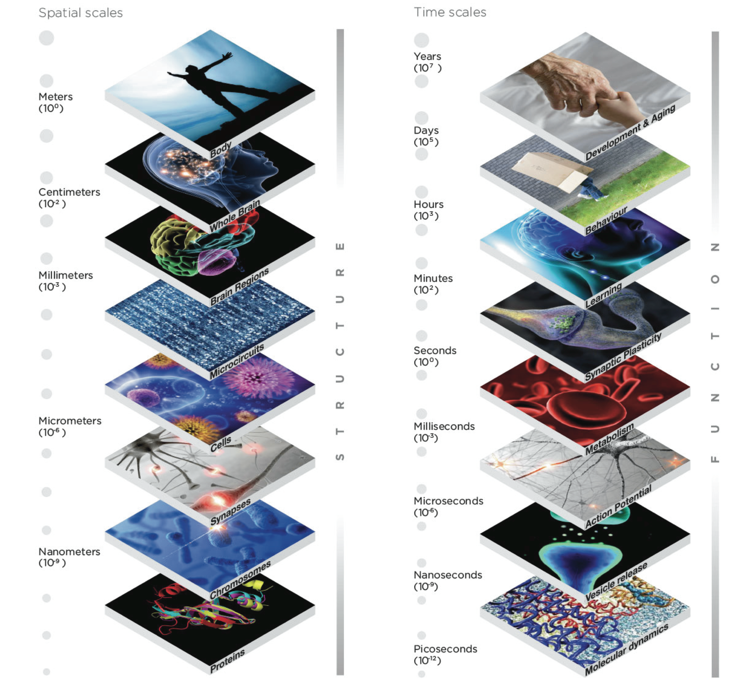
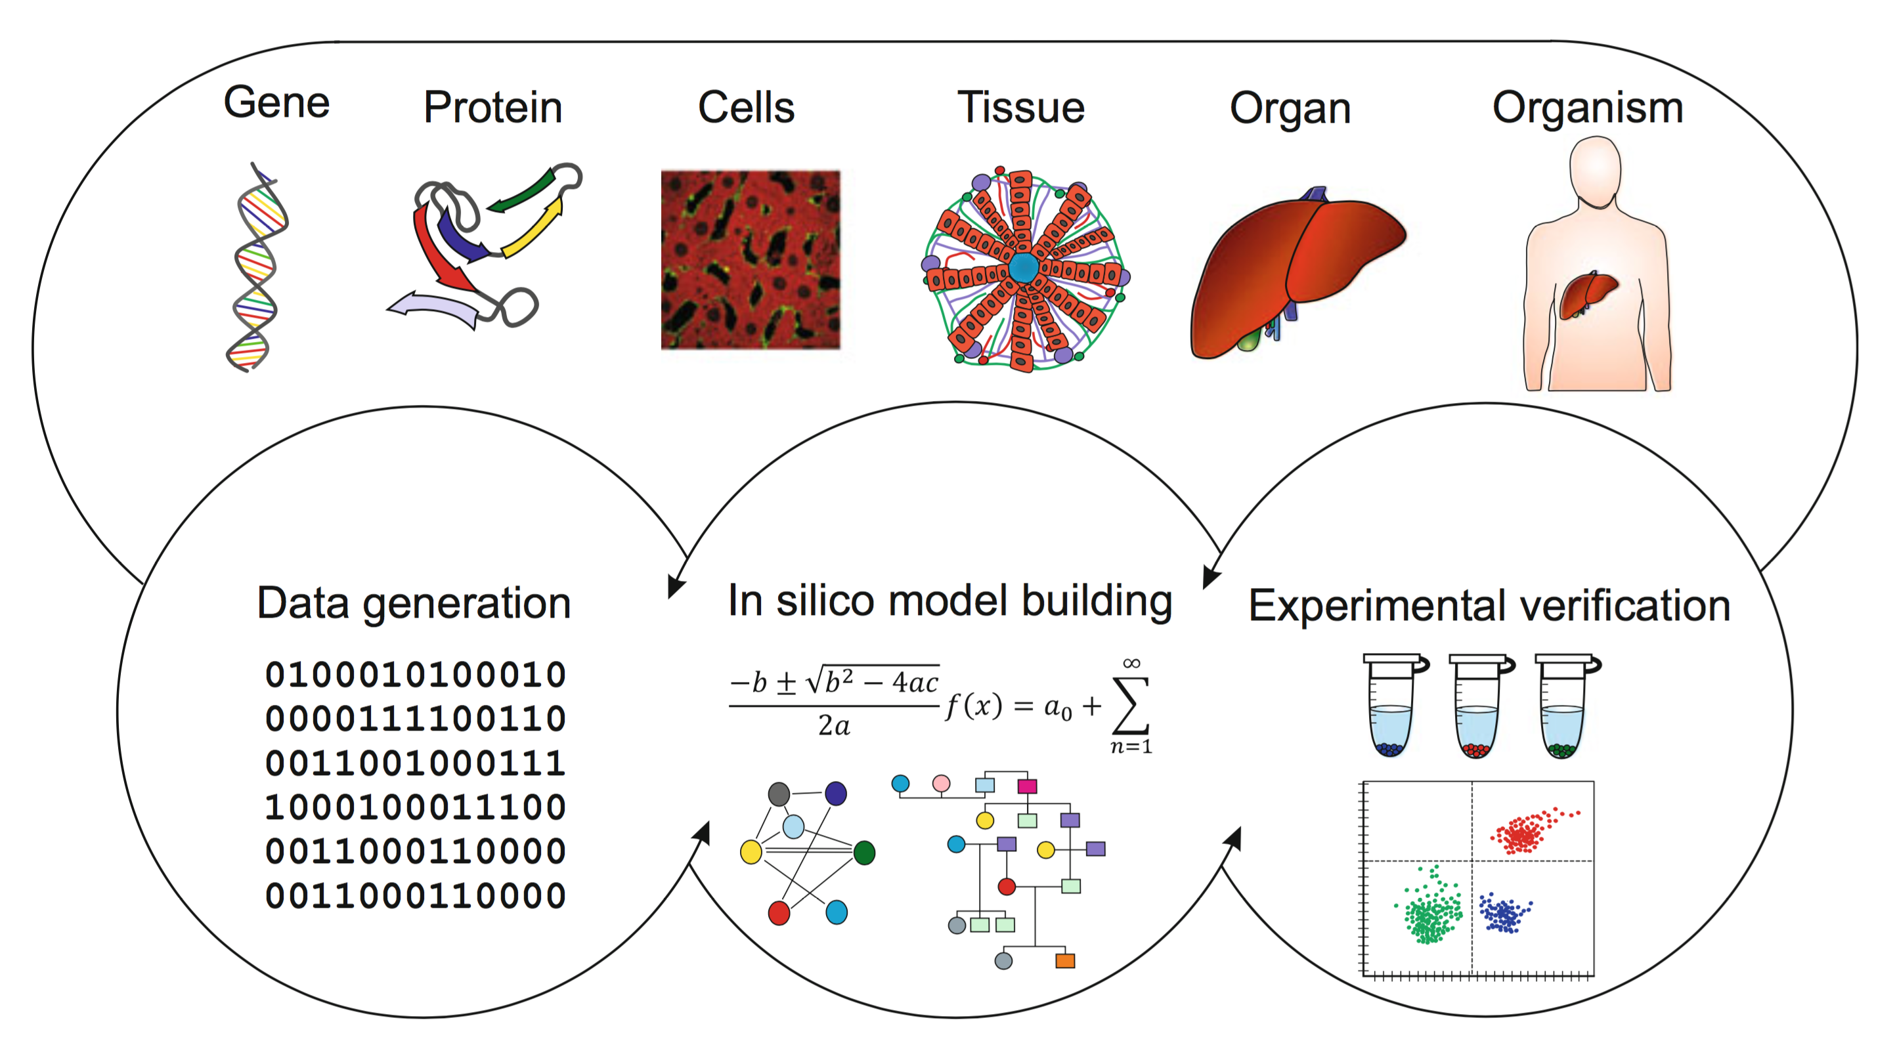
TRENDS
Systems medicine and computational imaging
MULTISCALE
Spatial scales
Time scales
S T R U C T U R E
F U N C T I O N
Ulf Schmitz, Olaf Wolkenhauer (eds) Systems Medicine, Springer, 2016
https://www.humanbrainproject.eu

Slide 4
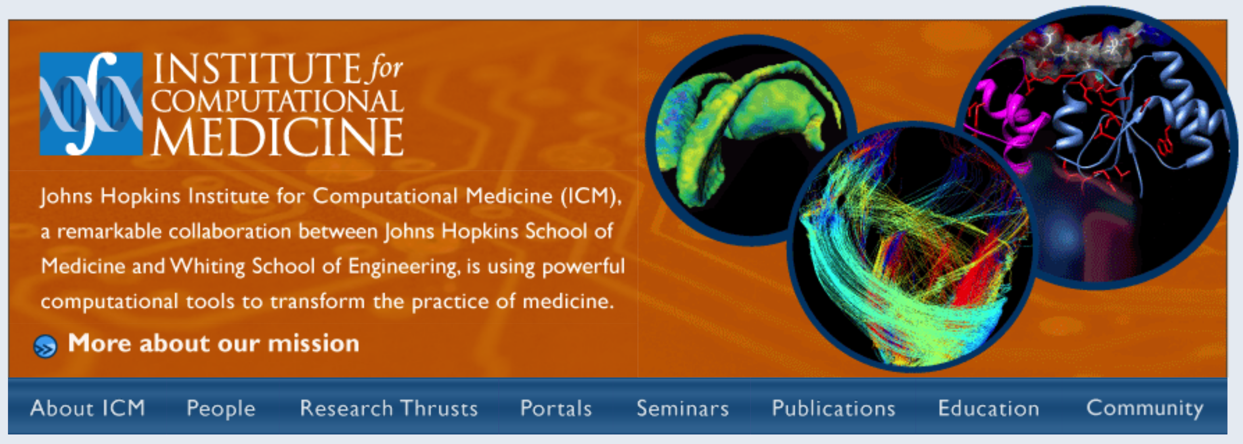
TRENDS
Computational Medicine
It will soon be common for clinical research studies to:
Collect genetic, transcriptional, proteomic, imaging and clinical data from every patient in large, carefully selected cohorts sharing a specific disease diagnosis.
Johns Hopkins University
The challenge of the coming decade will be
- how best to use these multi-scale biomedical data
- to gain a quantitative understanding of disease mechanisms
- across hierarchical levels of biological organization
- to identify biological markers which correlate with different disease states
- and inter-individual differences in disease risk
Discover more effective therapeutics targeted to the individual
http://www.icm.jhu.edu

Slide 5
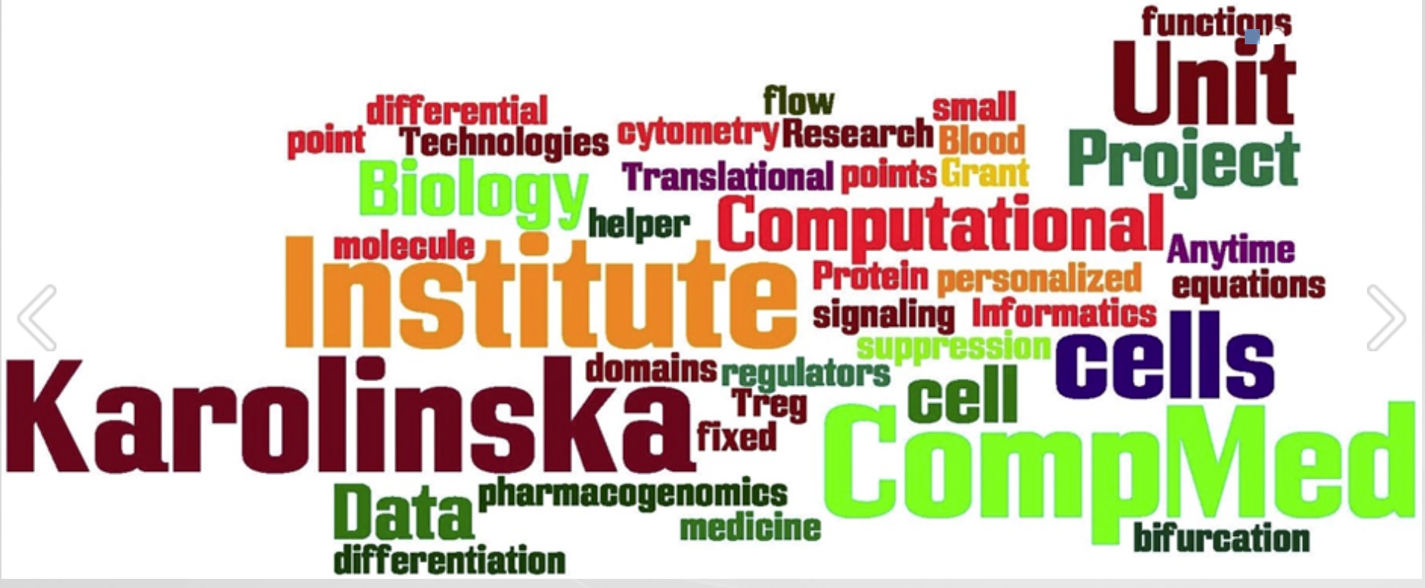

TRENDS
Unit of Computational Medicine - Karolinska Institutet
Uniquely integrated multidisciplinary team of more than 30 scientists from
- pure and applied mathematics
- immunology
- physics
- midwifery
- complexity theory
- cell and molecular biology
- computer science
- pharmacology
- engineering
- medicine
develop and apply integrative
computational-experimental approaches
provide fundamental insights of
life beyond physics
enable prediction, prevention and
treatment of diseases
http://www.compmed.se

Slide 6

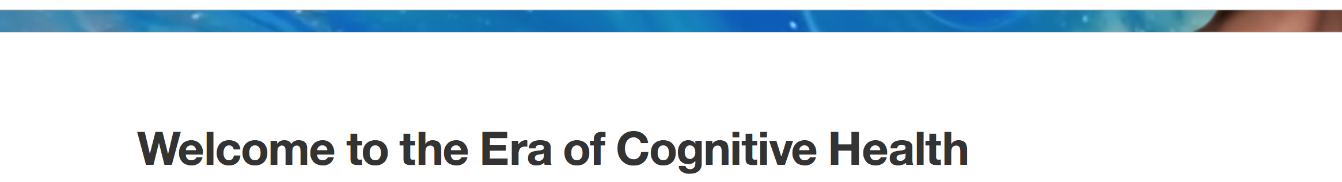
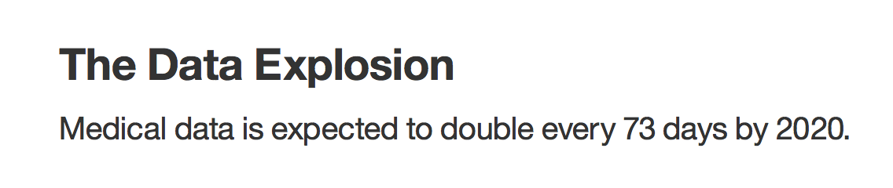
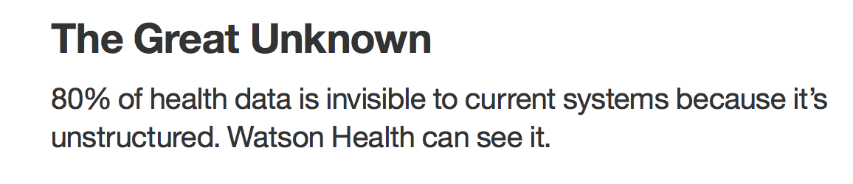
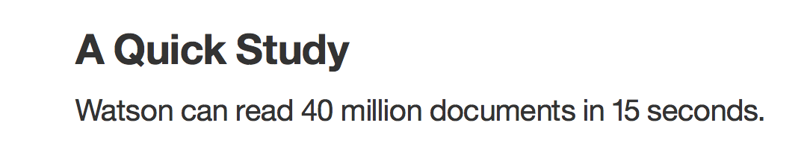
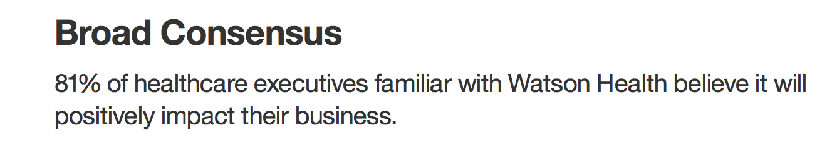
TRENDS
http://www.ibm.com/smarterplanet/us/en/ibmwatson/health
“
“
Cognitive computing
IBM Watson Health is pioneering a new partnership between humanity and technology with the goal of transforming global health. Cognitive systems that understand, reason and learn are helping people expand their knowledge base, improve their productivity and deepen their expertise.
With cognitive computing, we are now able to see health data that was previously hidden, and do more than we ever thought possible.

Slide 7
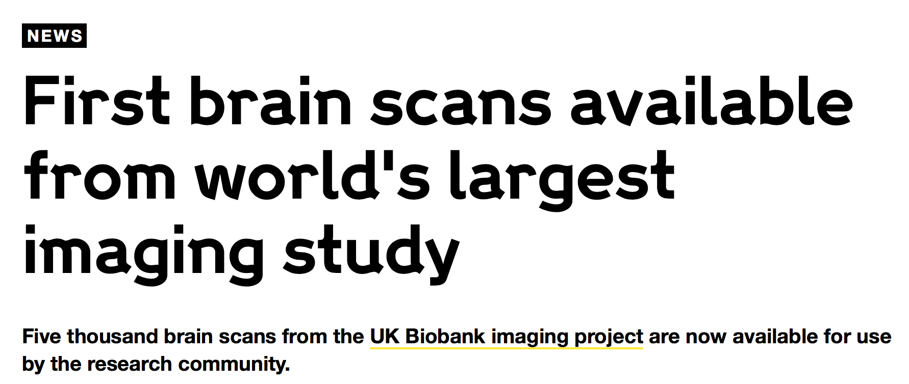
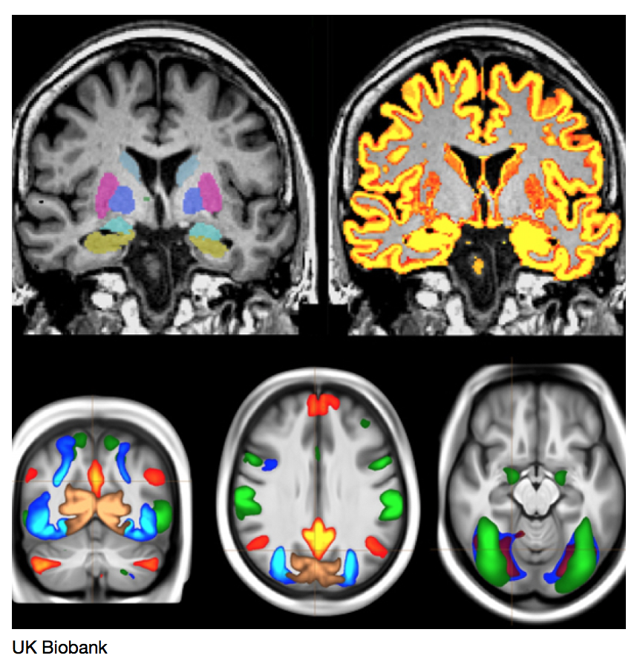
TRENDS
N = 100 000
http://www.ukbiobank.ac.uk
http://www.nature.com/neuro/journal/vaop/ncurrent/full/nn.4393.html
Medical imaging has enormous potential for early disease prediction, but is impeded by the difficulty and expense of acquiring data sets before symptom onset.
UK Biobank aims to address this problem directly by acquiring high-quality, consistently acquired imaging data from 100,000 predominantly healthy participants, with health outcomes being tracked over the coming decades.
The brain imaging includes structural, diffusion and functional modalities. Along with body and cardiac imaging, genetics, lifestyle measures, biological phenotyping and health records, this imaging is expected to enable discovery of imaging markers of a broad range of diseases at their earliest stages, as well as provide unique insight into disease mechanisms.
We describe UK Biobank brain imaging and present results derived from the first 5,000 participants' data release. Although this covers just 5% of the ultimate cohort, it has already yielded a rich range of associations between brain imaging and other measures collected by UK Biobank.
Miller et al. Multimodal population brain imaging in the UK Biobank prospective epidemiological study. Nature Neuroscience (2016)

Slide 8
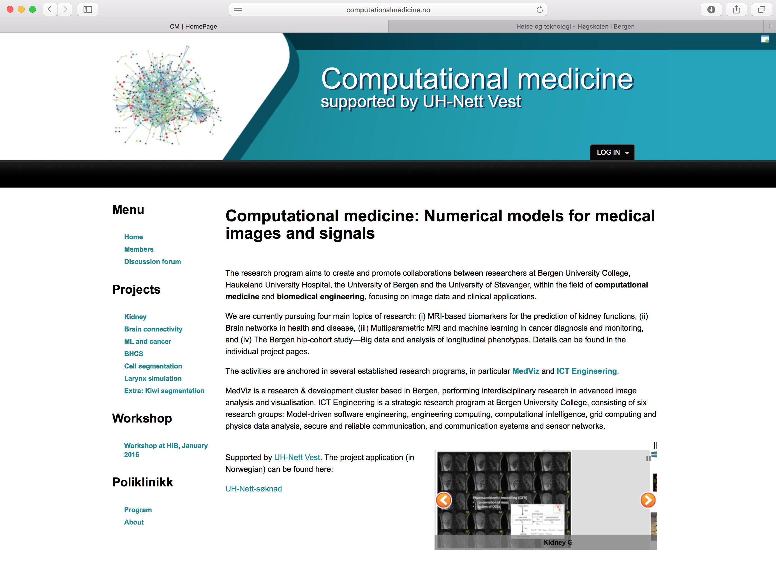
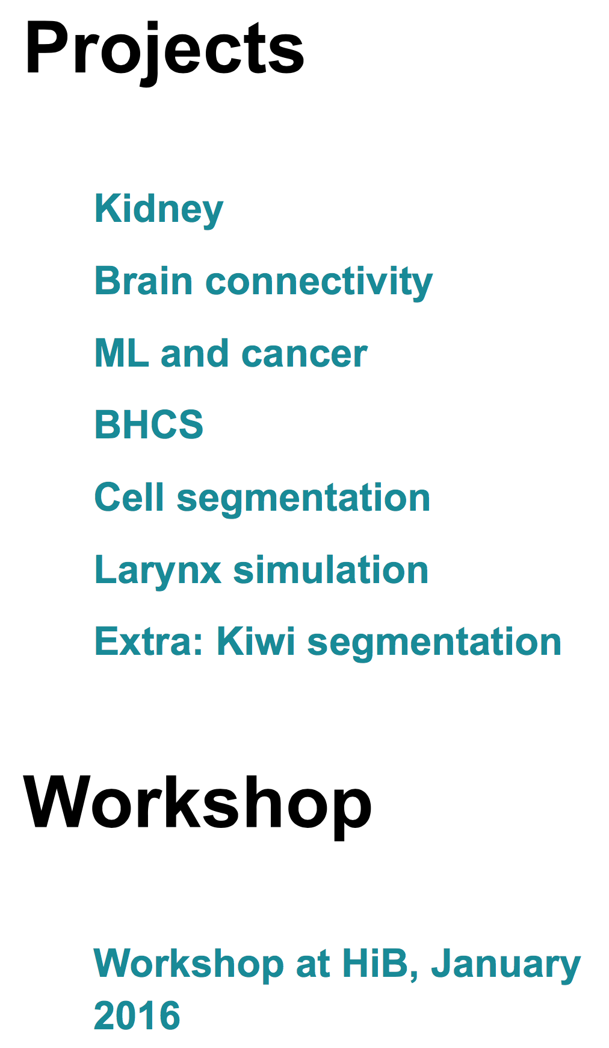
TRENDS
computationalmedicine.no
UiB, IRIS, HiB

Slide 9
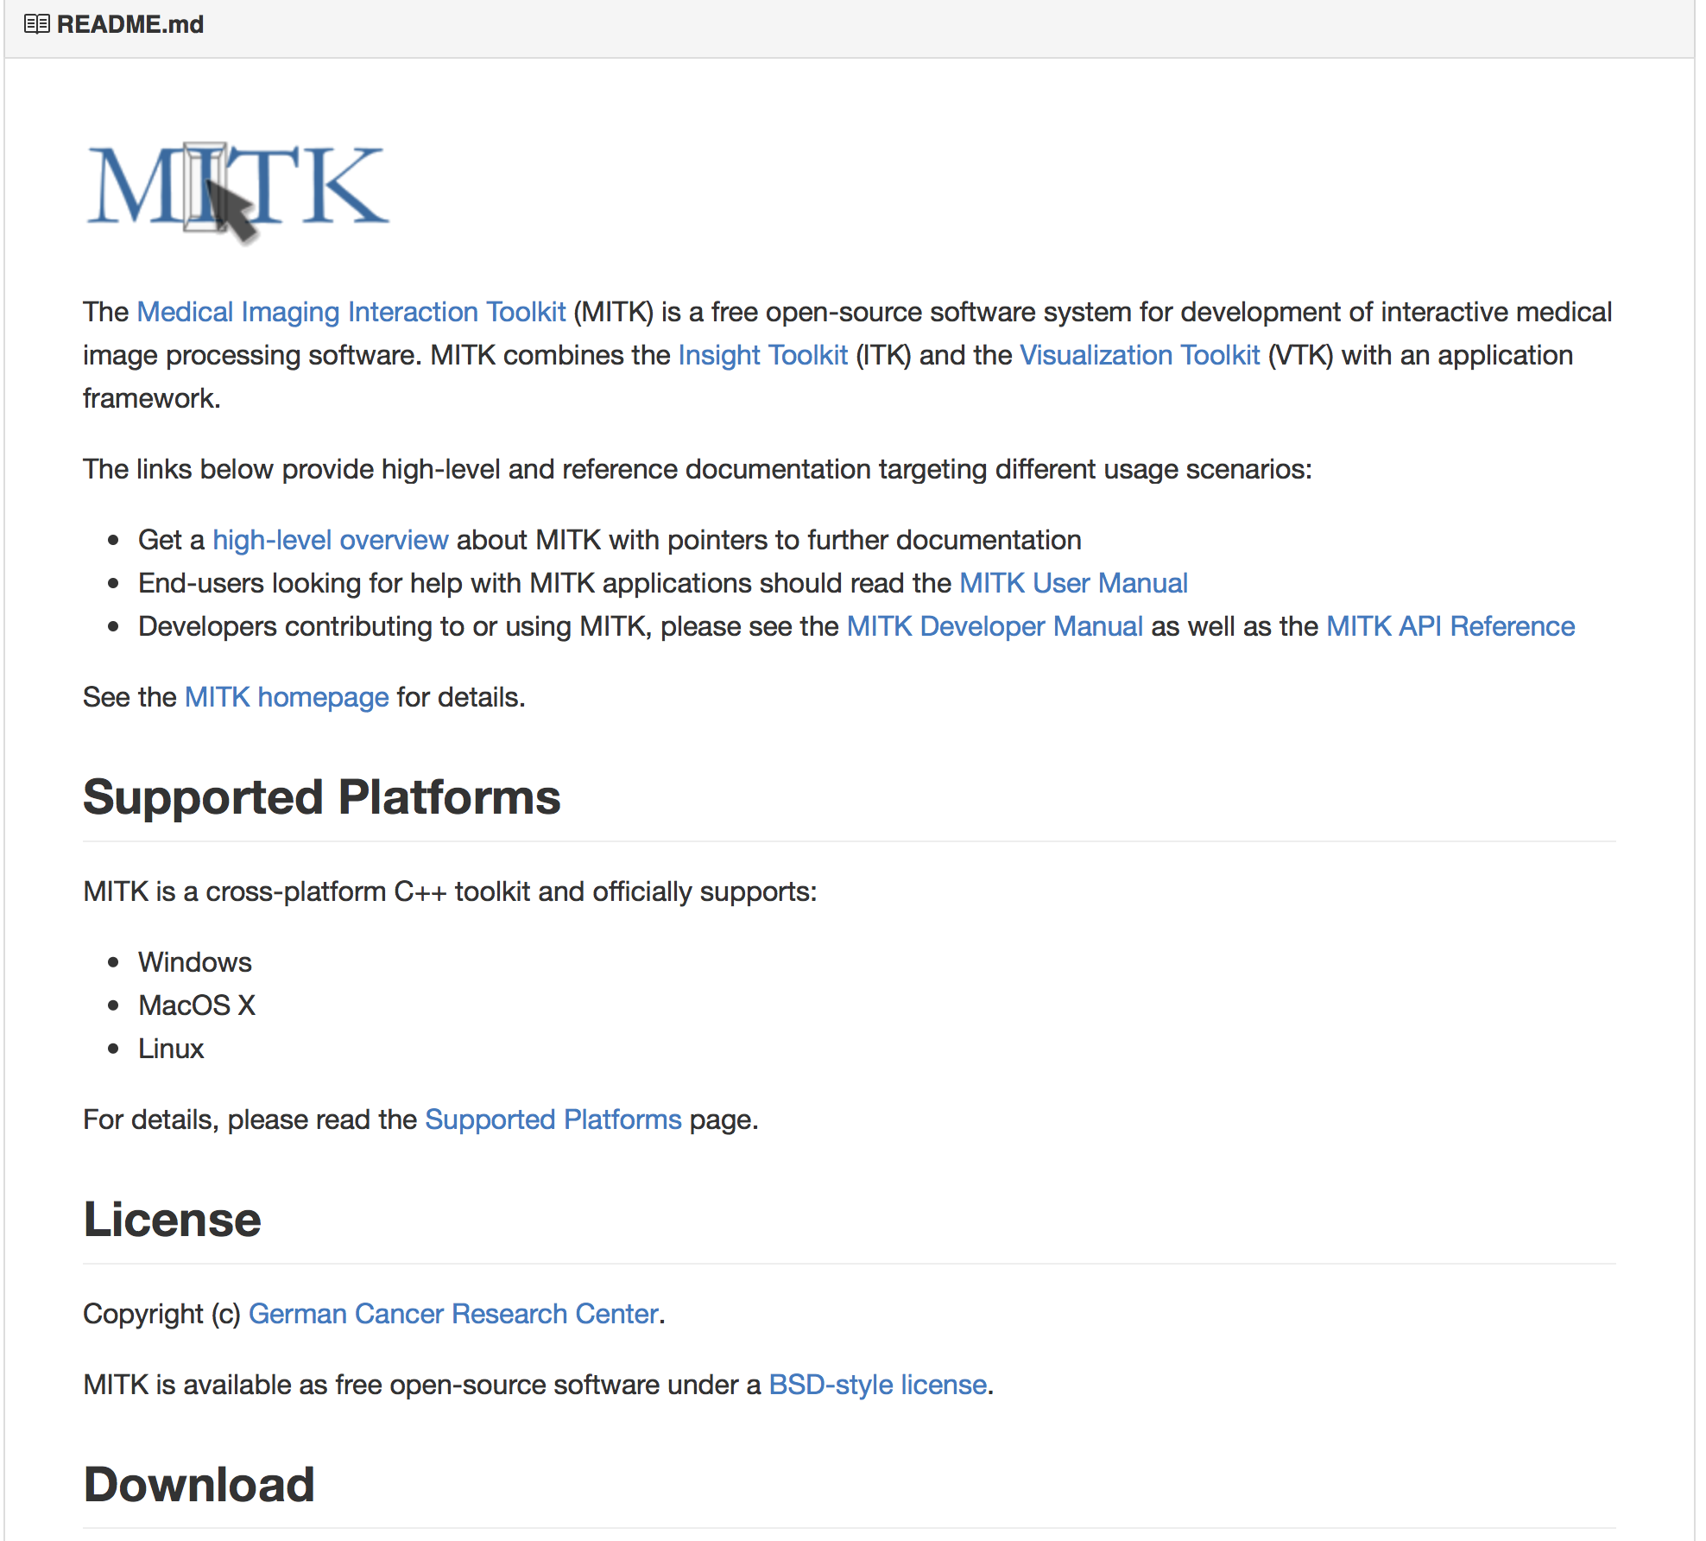
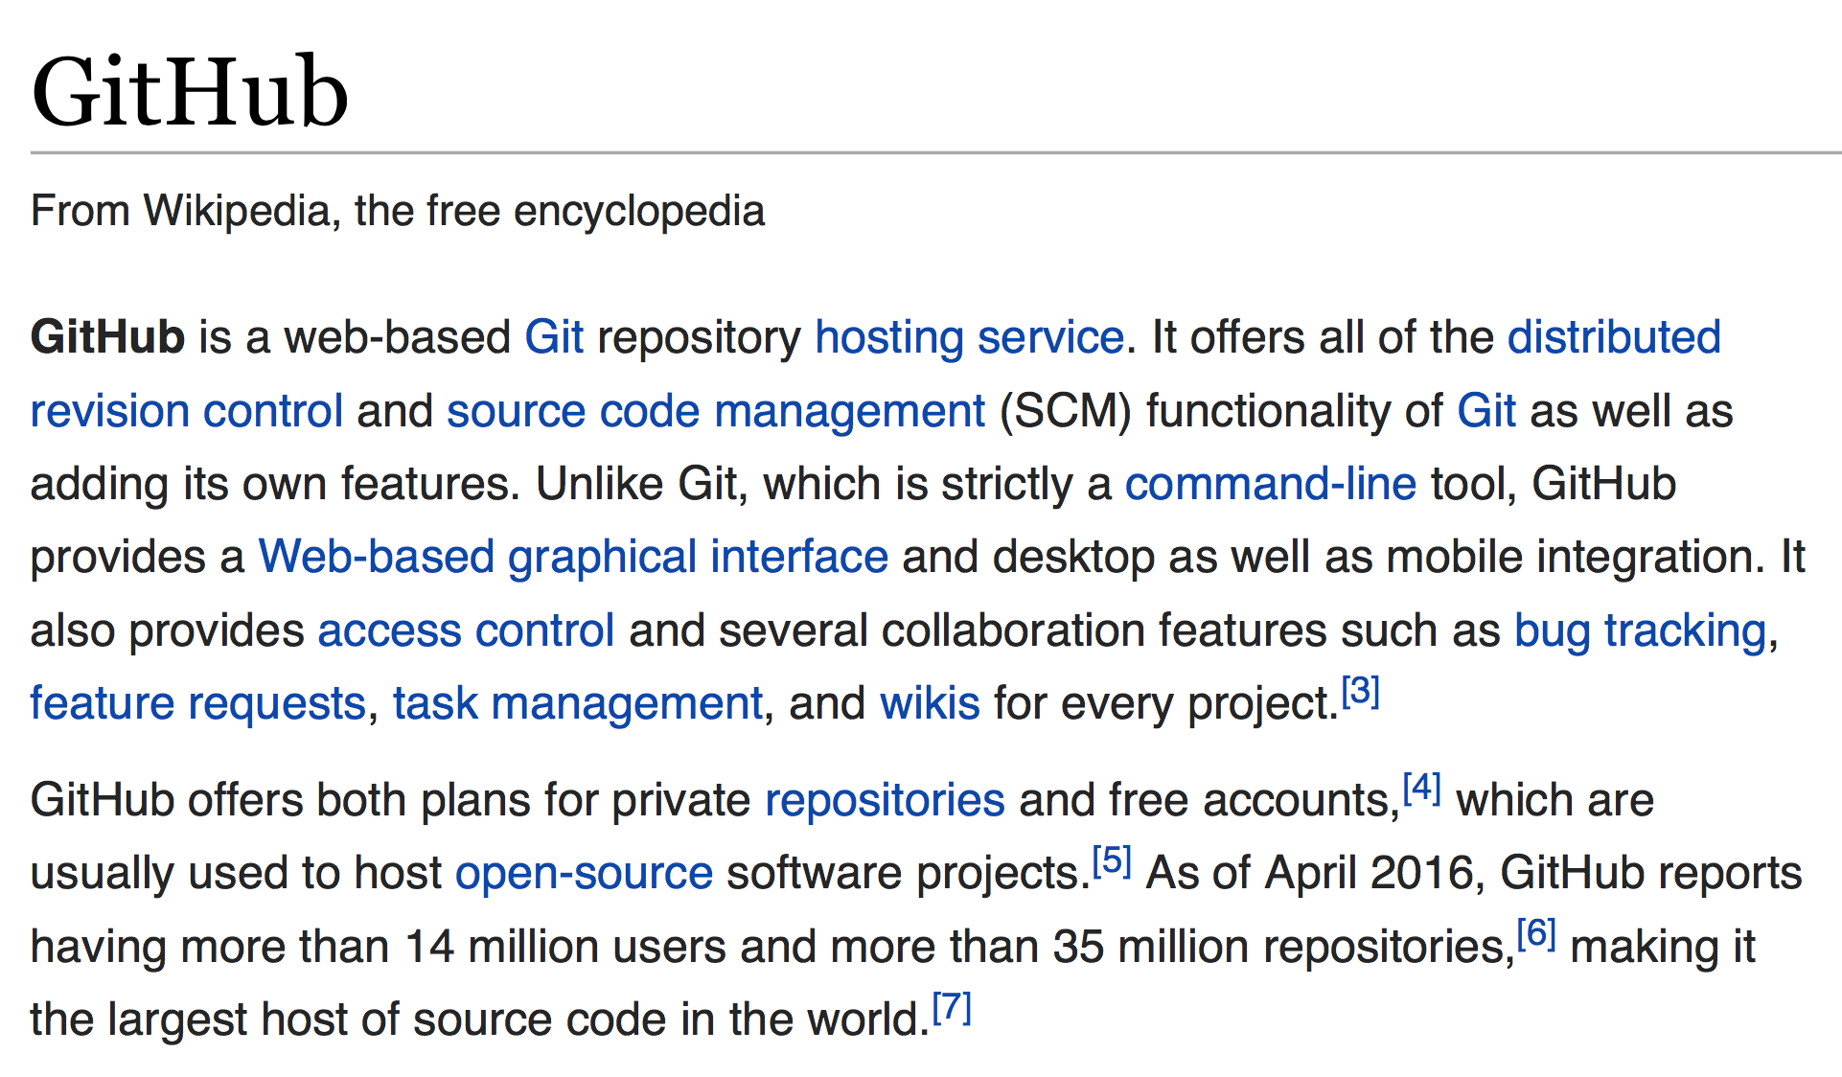
Reproducible research – Open Science – Open source
TRENDS
Computational medicine
& Software development
Example
"Build software better, together"

Slide 10

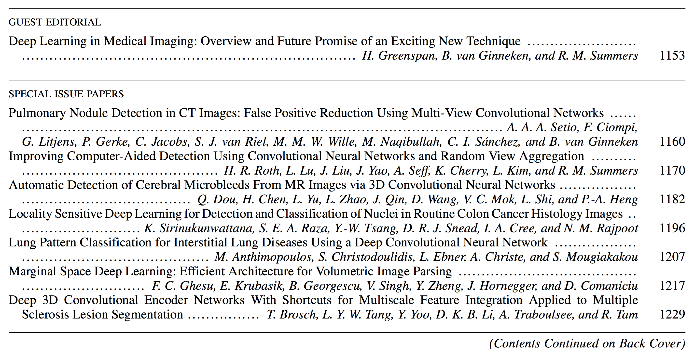
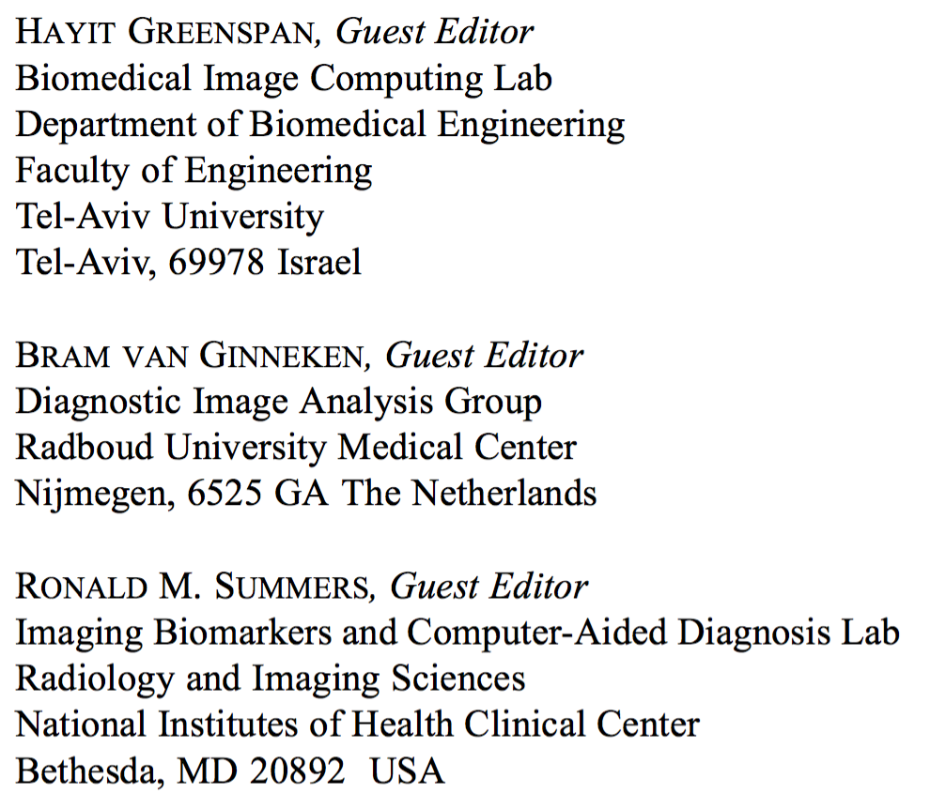
TRENDS
Data analytics - Machine learning
Deep learning is a growing trend in general data analysis and has been termed one of the 10 breakthrough technologies of 2013 [1]. Deep learning is an improvement of artificial neural networks, consisting of more layers that permit higher levels of abstraction and improved predictions from data [2]. To date, it is emerging as the leading machine-learning tool in the general imaging and computer vision domains.

Slide 11
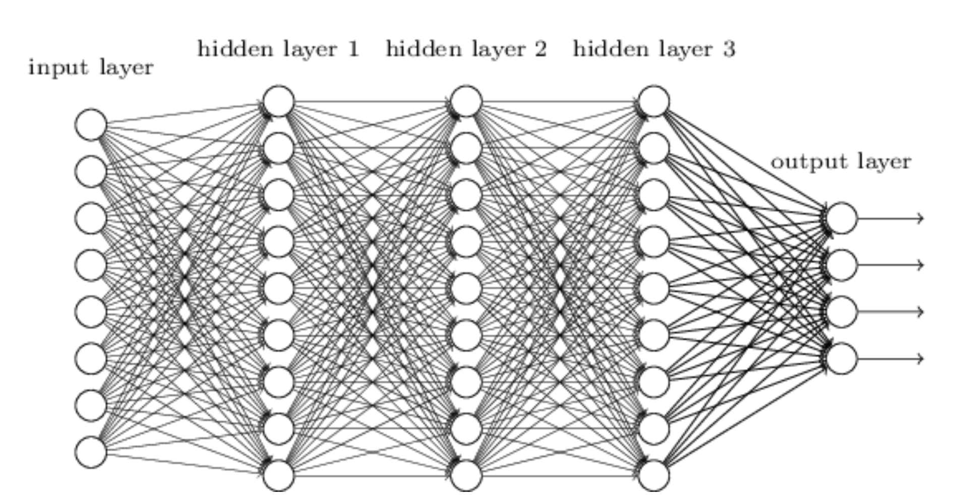
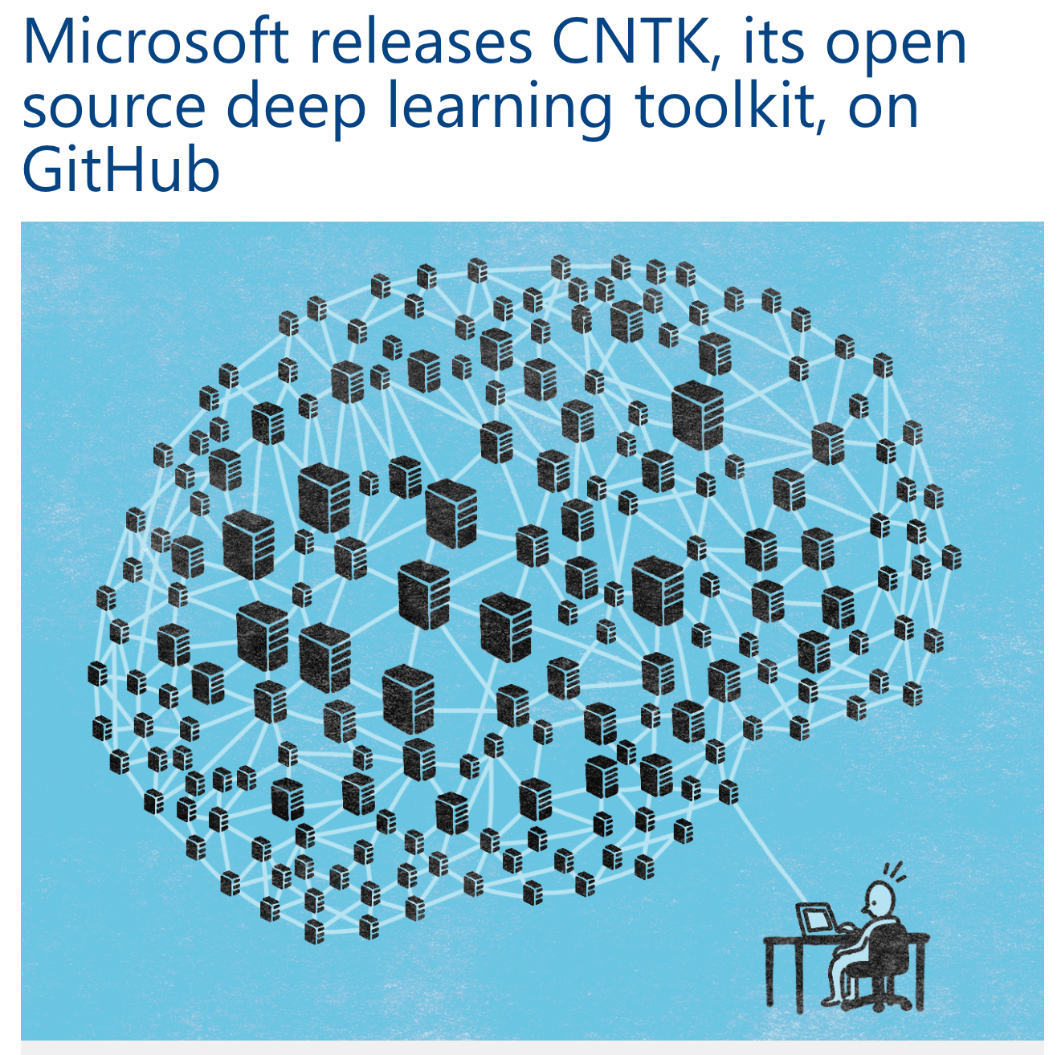
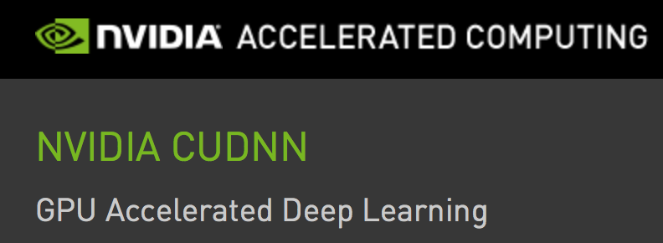
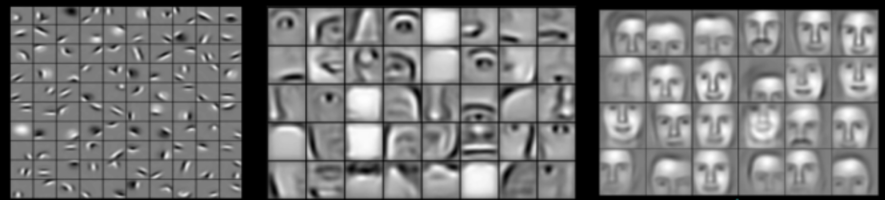

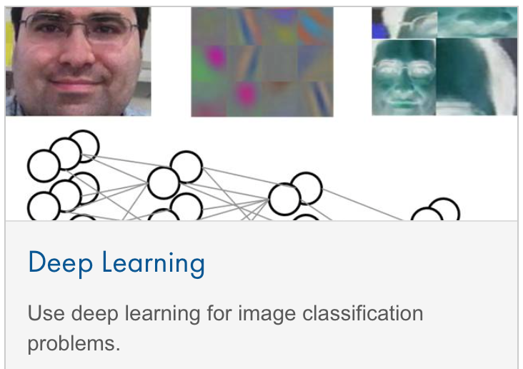
Neural networks - deep learning
TRENDS
Deep learning is a branch of machine learning based on a set of algorithms that attempt to model high-level abstractions in data by using multiple processing layers, with complex structures or otherwise, composed of multiple non-linear transformations
Input layer
Hidden layer 1
Hidden layer 2
Hidden layer 3
Output layer
Wikipedia
l a y e r s o f f e a t u r e s
Notes:
Functional MRI voxel time courses and spatio-temporal activity patterns

Slide 12
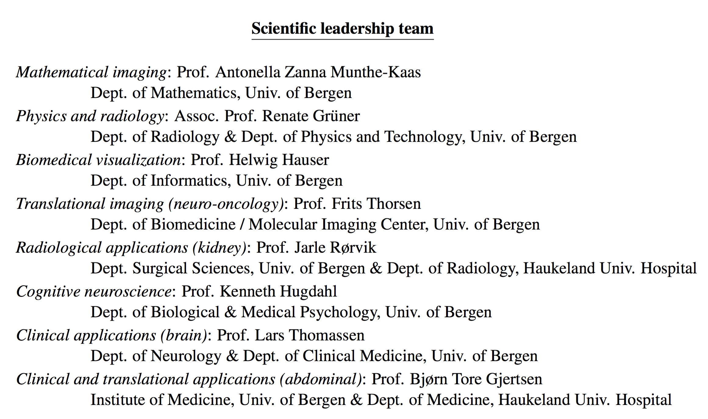
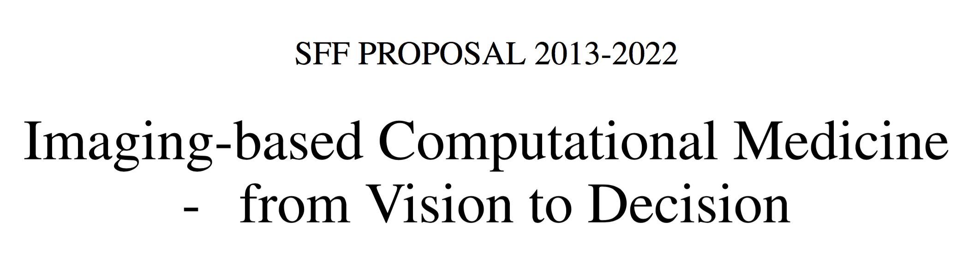
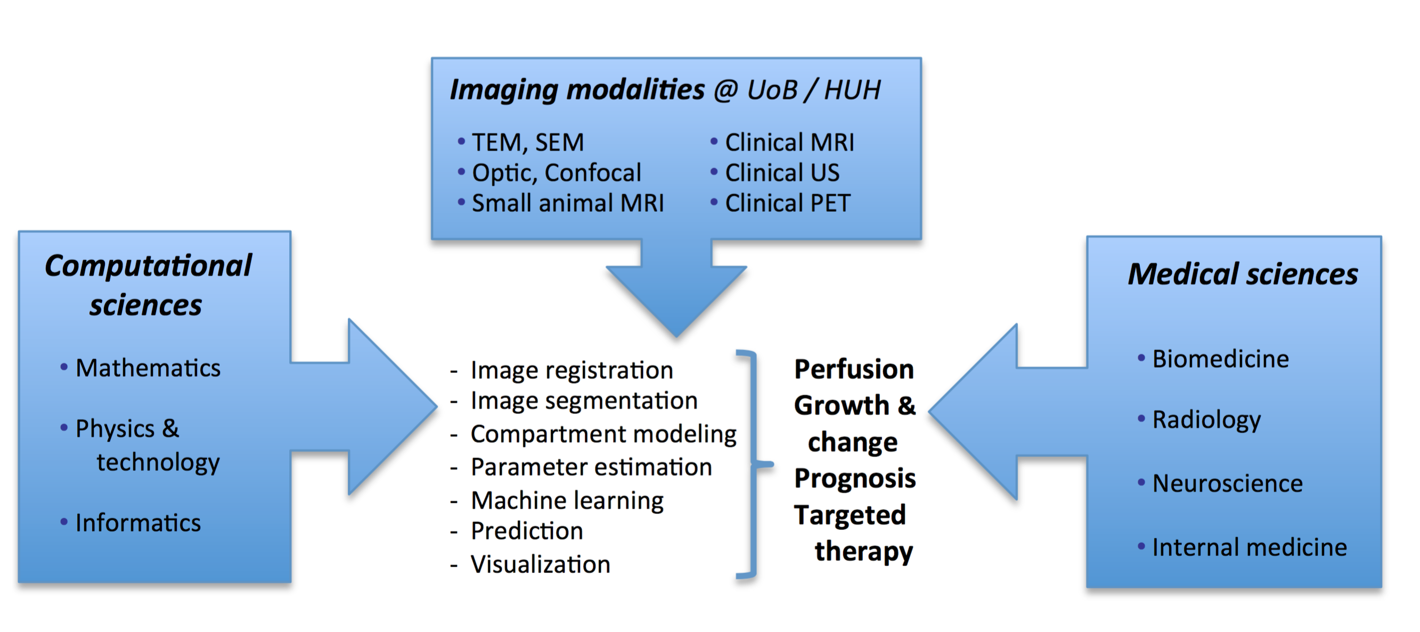
Bergen-based collaboration
HiB
(matematikk/data/helse)
Uni Research Computing
(Center for Big Data Analysis)
CMR
IRIS
NordicNeuroLab

Slide 13
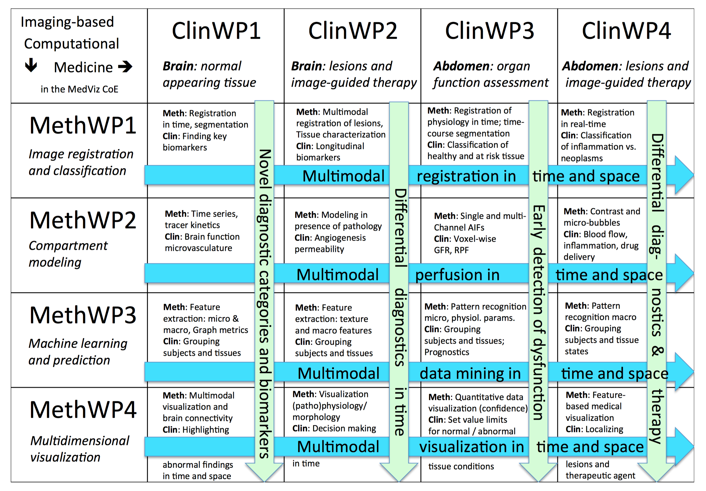
Interdiciplinary
collaboration
Matrix coupling
between
the MethWPs and
the ClinWPs

Slide 14
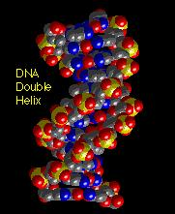
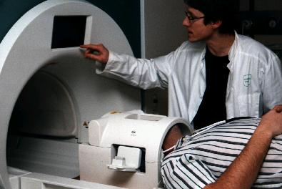
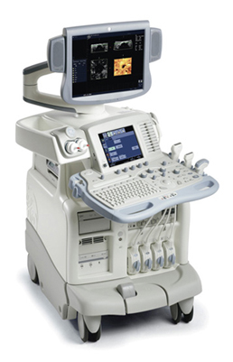
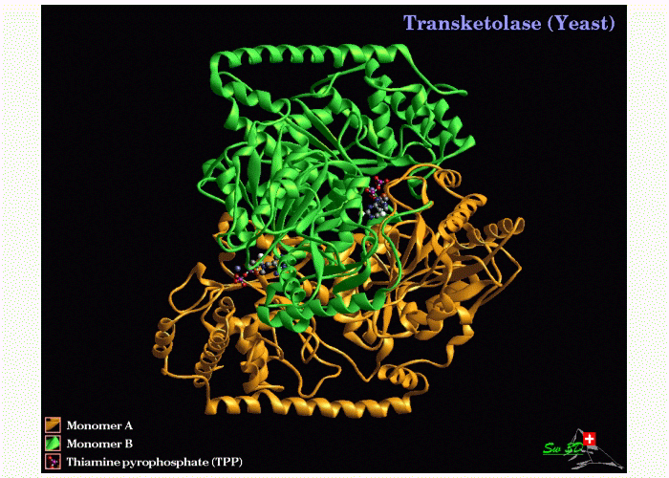
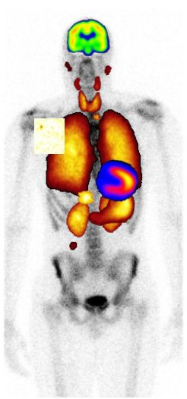
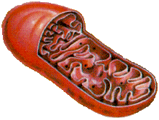
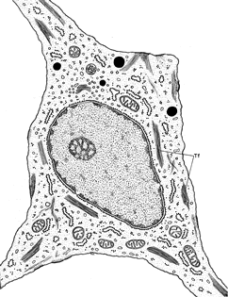
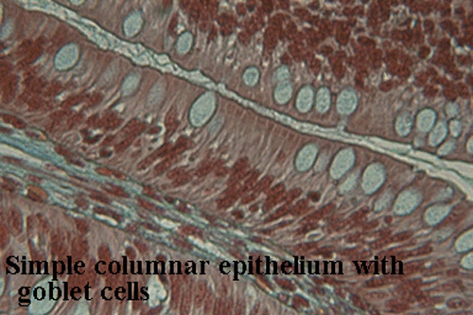
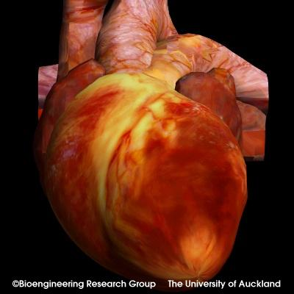
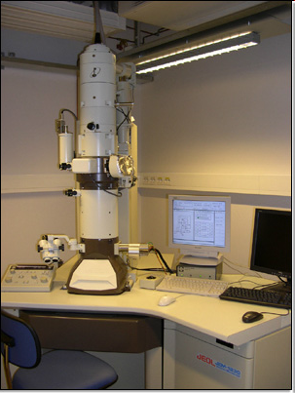
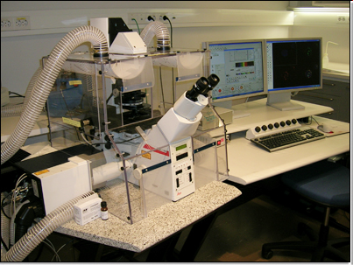
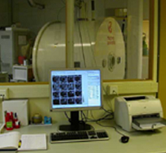

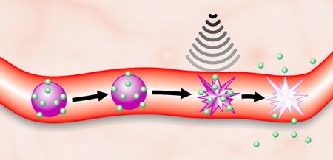
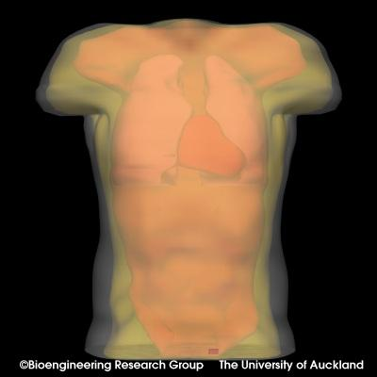
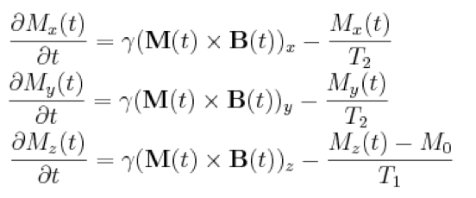
Imaging infrastructure at HUH and MIC
INFRASTRUCTURE
Superresolution microscopy (STED)
MRI expert ( acquisition + analysis )
- New visualization center from 2017
DNA
Clinical MRI
Clinical US
Protein
Clinical PET/CT
Organelle
Cell
1 GE + 2 x Siemens 3 Tesla
Tissue
Microscopy
EM
Organ
Confocal
Animal MRl
Organism
7 Tesla Bruker Pharmascan

Slide 15
Selected research project proposals
“ NeuroAGE ”
- Centre for research into age-related neurodegenerative diseases SFF-application
Prof. Laurence Bindoff /
Prof. Aurora Martinez
“ Gut Feelings “
- The brain-gut-microbiota interaction: role in functional gastrointestinal disorders
NFR FRIMEDBIO
Prof. Trygve Hausken
“ From geophysics to cancer “
Imaging-based modeling and in-vivo estimation of interstitial fluid flow in cancer
Norwegian Cancer Society
Prof. Antonella Z Munthe-Kaas / IRIS

Slide 16
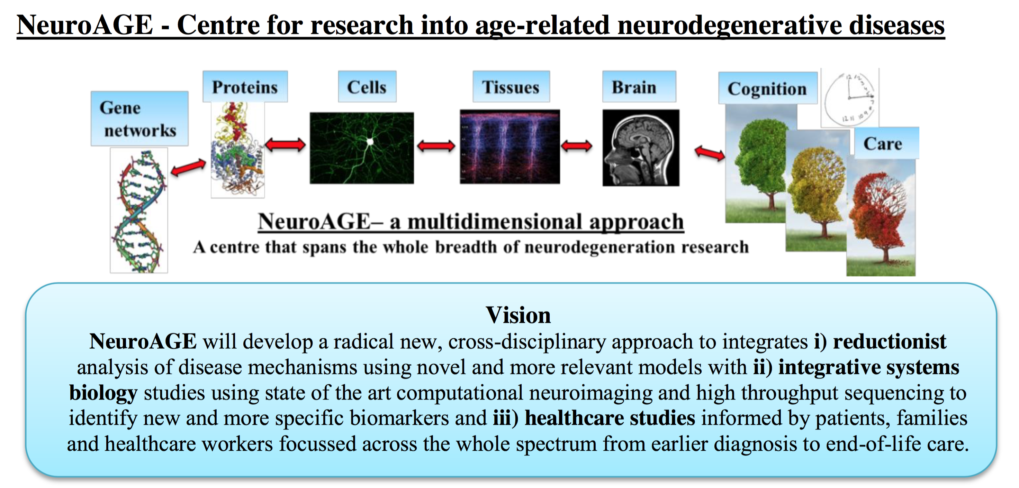
SFF application (second round) submitted May 25th 2016

Slide 17
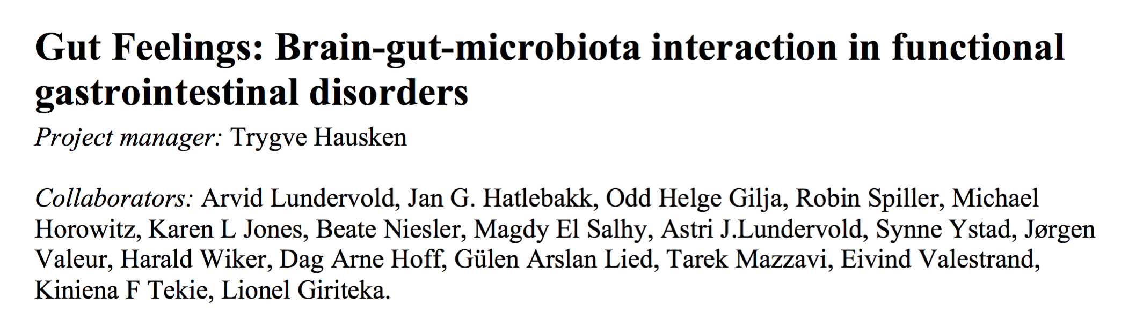
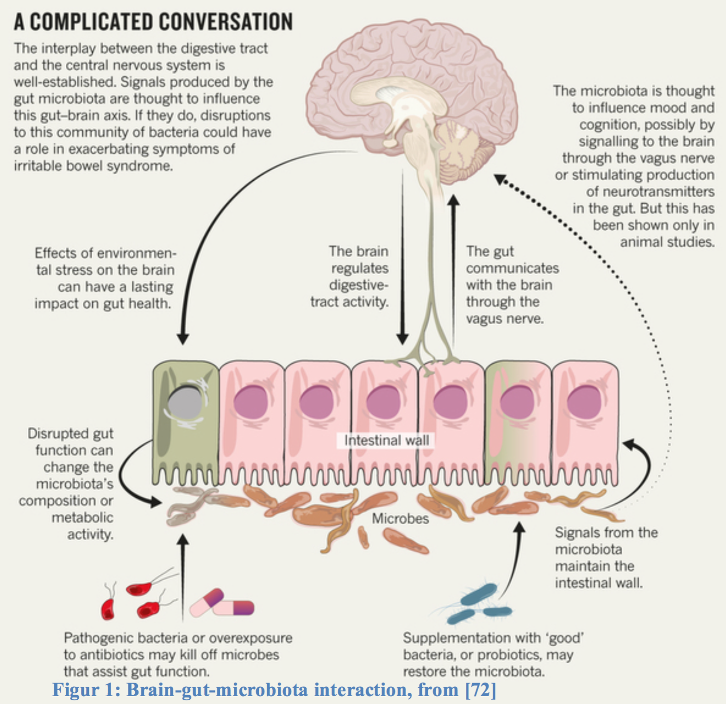
Gut Feelings

Slide 18
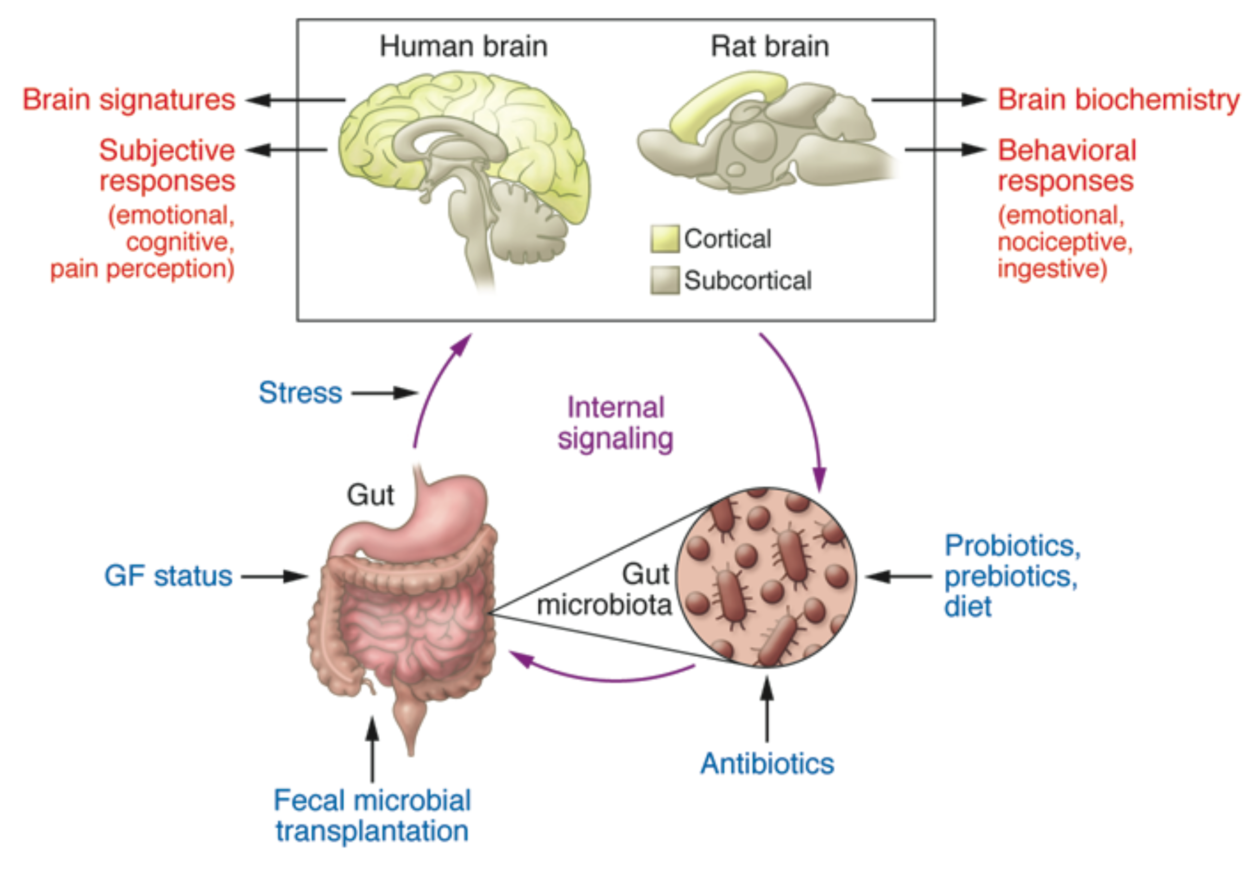

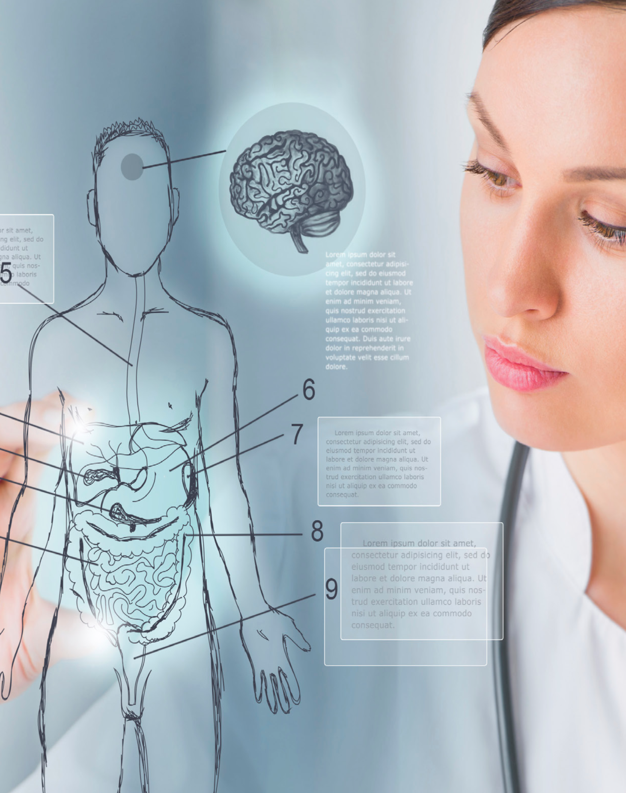
Gut Feelings
The Brain-Gut axis and the irritable bowel syndrome (IBS)
Brain signatures*
Subjective
responses
(emotional,
cognitive,
pain perception)
* Imaging biomarkers
Adopted from: Mayer EA, Tillisch K, Gupta A. Gut/brain axis and the microbiota. The Journal of Clinical Investigation 2015;125(3)

Slide 19
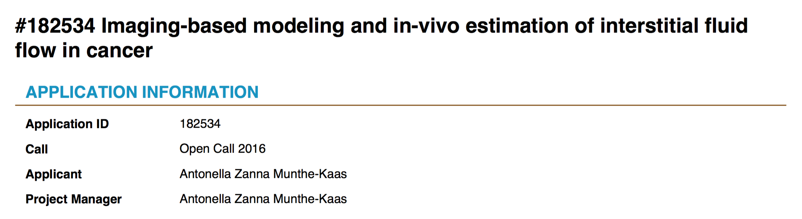

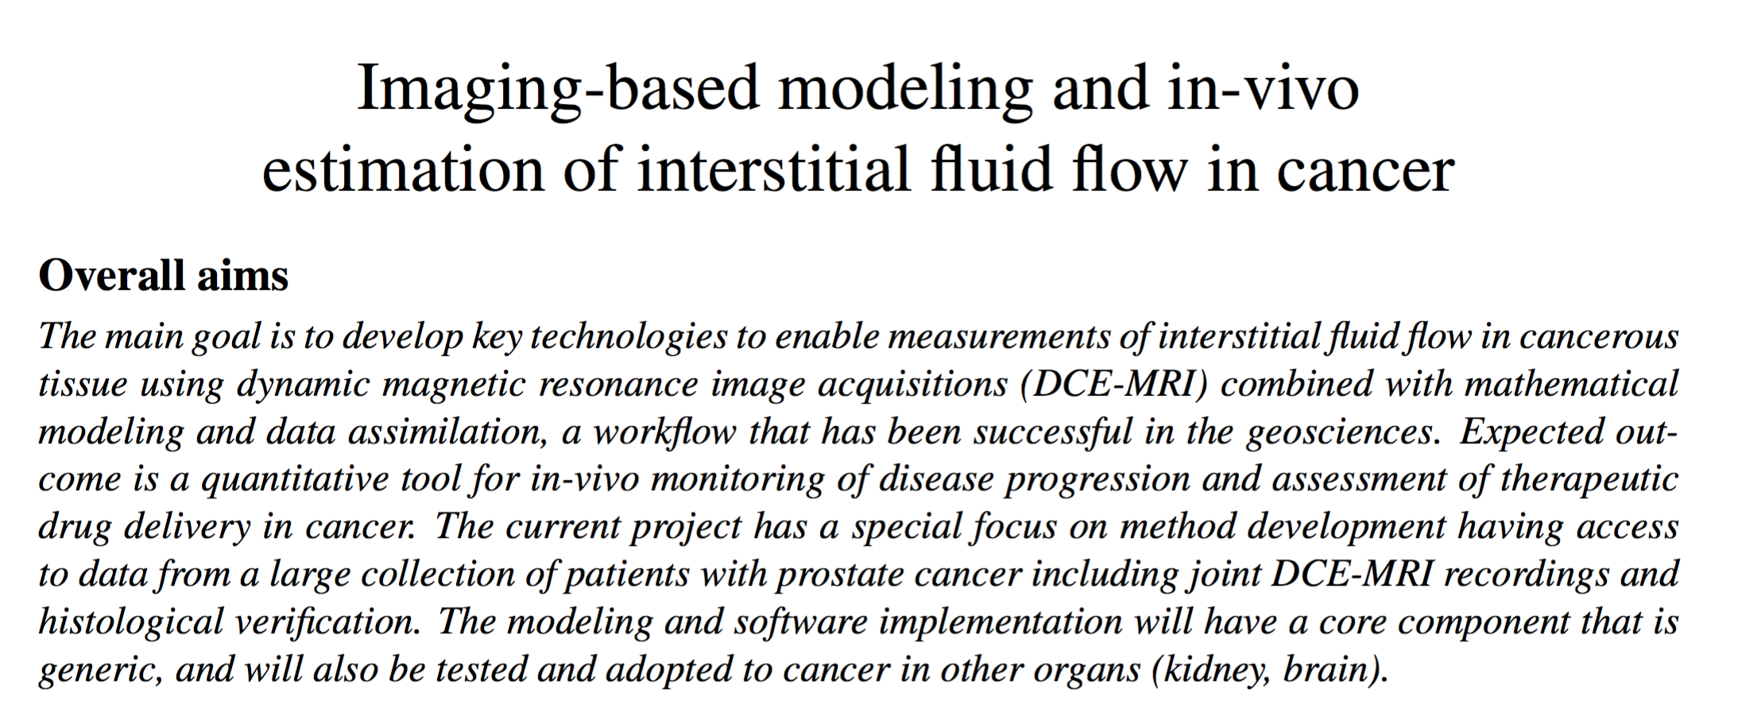

Slide 20









The future of medicine …
- mindset
- skillset
- toolset
SYSTEMS BIOLOGY , SYSTEMS MEDICINE and COGNITIVE HEALTHCARE
INTERDISCIPLINARITY and COMPUTATIONAL APPROACHES
addressing the multi-scale nature of organs and tissues in health and disease
- open science
- reproducible
research
SPACE:
Atom
10⁻¹² m
Protein
10⁻⁹ m
Cell
10⁻⁶ m
Tissue
10⁻³ m
Organ
10⁰ m
Anatomy
Organ system
& organism
Physiology
Brain
Spinal
cord
Peri-
pheral
nerves
Gene
networks
Pathway models
Stochastic models
Ordinary
Differential
Equations
Continuum models
(Partial Differential
Equations)
Systems models
TIME:
10⁻⁶ s
molecular events
(ion channel gating)
10⁻³ s
diffusion
cell signalling
10⁰ s
motility
10³ s
mitosis
10⁶ s
protein
turnover
10⁹ s
human
lifetime
From: C. Dollery and R. Kitney, Systems biology: A vision for engineering and medicine, Tech. report, The Academy of Medical Sciences and The Royal Academy of Engineering, London, UK, Feb. 2007.

Slide 21
The aim is to establish a common platform for innovation and project development across academic and between public and private actors.
Collaborative projects in “Computational medicine”, e.g.
? APPLICATIONS
? METHODS
Imaging-based biomarkers
Aging and neurodegeneration
Brain-Gut-Microbiota interaction
Kidney function
Computational imaging
Machine learning
Predictive modelling
Visual analytics

